Slide 1
Data Warehousing & Business Intelligence
Prof. Saed SAYAd

Slide 2
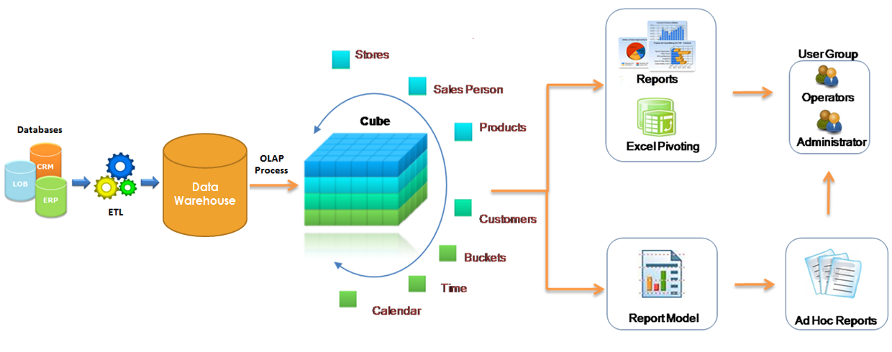
Data for Decision Making
Business Intelligence(BI)

Slide 3
Data for Decision Making
Strategic level
Senior management whose decisions related to strategy involve company-wide matters enacted over the long term
Senior management must translate the vast scope of mission and vision (such as growth or diversification) into concrete achievements over time
Of all management levels, upper managers spend the most time making decisions involving plans
Tactical level
Once upper management decides the overall direction of the company it’s up to middle management to choose smaller tactical objectives that, put together, accomplish strategic goals
Middle managers create tactical plans, which have more detail than strategic plans with some measurable efficiency or quality improvement
Operational level
Day-to-day business decisions with short time frame
On-Line Transaction Processing (OLTP)
On-Line Analytical Processing (OLAP)

Slide 4
Data Warehouse
“A data warehouse (DW or DWH) is a subject-oriented, integrated, time-variant, and nonvolatile collection of data in support of management’s decision-making process.” (Inmon, 1996)
In computing, a data warehouse, also known as an enterprise data warehouse (EDW), is a system used for reporting and data analysis, and is considered a core component of business intelligence
DWs are central repositories of integrated data (current and historical ) from one or more disparate sources

Slide 5
Data & Process Integration
Data integration aims at providing a unified view and/or unified access over heterogeneous, and possibly distributed, data sources
Process integration deals with sequencing of tasks in a business process but also governs data flows in these processes (e.g., loan approval process)
control-flow: correct sequencing of tasks
data flow: inputs/outputs of the tasks
Two types of dependencies
sequence dependency: execution of service B depends on the completion of the execution of service A
data dependency: execution of service B depends on data provided by service A

Slide 6
Data Quality
Data quality can be defined as “fitness for use”:
data accuracy: to be accurate, a data values must be the right value and must be represented in a consistent and unambiguous form
data completeness: refers to an indication of whether or not all the data necessary to meet the current and future business information demand are available in the data resource
data consistency: ensures that the same data that is being used in different parts of the system will always be the same. The data is consistent across the entire system.
data accessibility: allows users to quickly find data in a (very) large DW
data timeliness : the availability and accessibility of data in making business decisions

Slide 7
Data Warehouse Definition
 | Transactional Database | Data Warehouse
Usage | Day to day business operations | Decision support at tactical/strategic level
Data latency | Real-time data | Periodic snapshots, incl. historical data
Design | Application oriented | Subject Oriented
Normalization | Normalized data | Denormalized data
Data manipulation | Insert/Update/Delete/Select | Insert/Select
Transaction management | Important | Less of a concern
Type of queries | simple transactional queries | Simple and complex (ad-hoc) queries

Slide 8
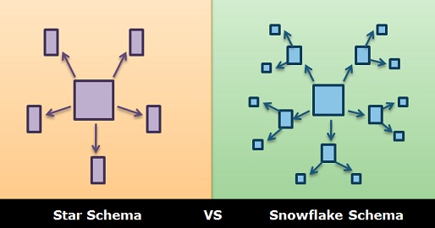
Data Warehouse Schemas
Star schema
Snowflake schema
Fact constellation

Slide 9
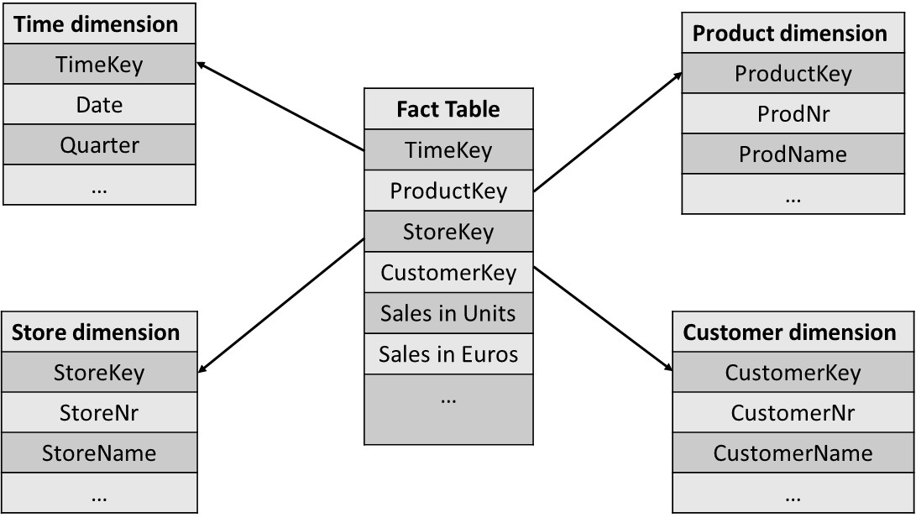
Star schema

Slide 10
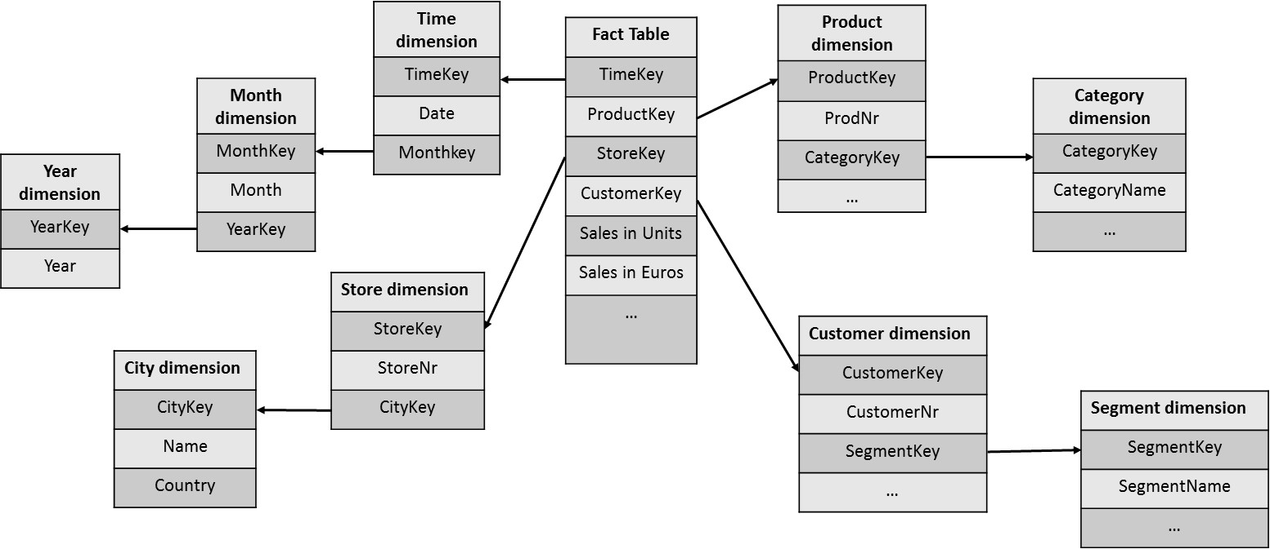
Snowflake Schema

Slide 11
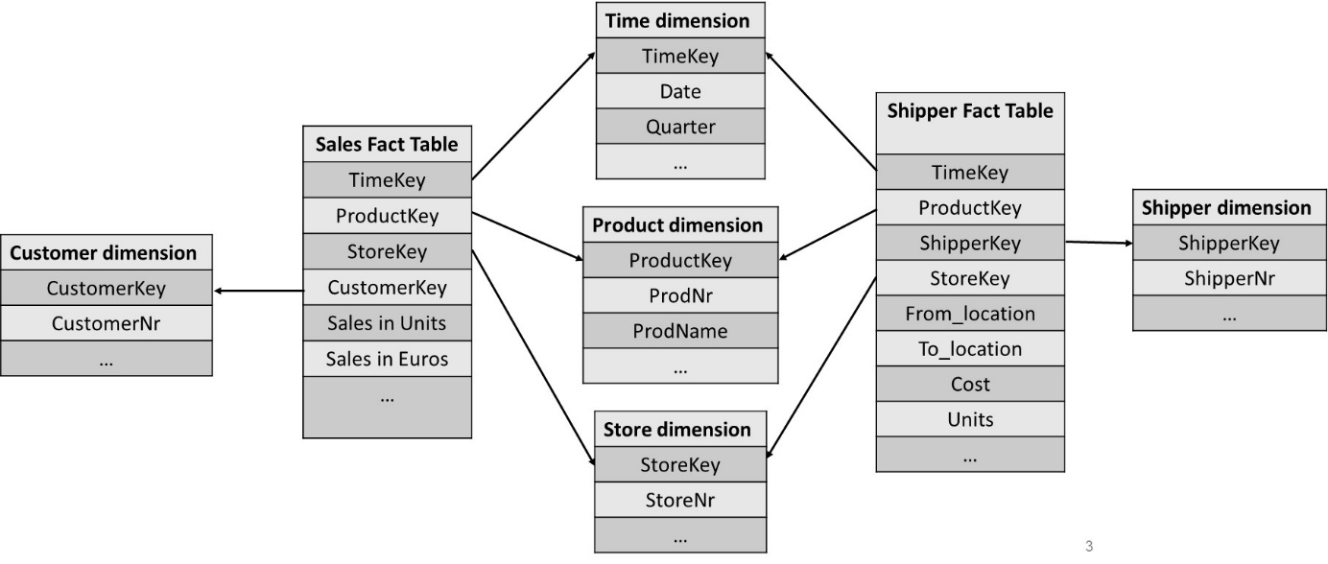
Fact Constellation

Slide 12
Specific Schema Issues
Surrogate keys
Granularity of the fact table
Factless Fact Tables
Optimizing dimensions
Defining junk dimensions
Defining outrigger tables
Slowly changing dimensions
Rapidly changing dimensions

Slide 13
Surrogate keys
Cannot use actual business keys (e.g., StoreKey, ProductKey, ShipperKey) since they usually have a business meaning
Surrogate keys essentially buffer the data warehouse from the operational environment
Surrogate keys are meaningless integers

Slide 14
Granularity of the fact table
Level of detail of one row of the fact able
Higher granularity implies more rows
Lower granularity implies fewer rows
Trade-off between level of detailed analysis and storage requirements
Examples:
One tuple of the fact table corresponds to one line on a purchase order
One tuple of the fact table corresponds to one purchase order (multiple lines)
One tuple of the fact able corresponds to all purchase orders made by a customer

Slide 15
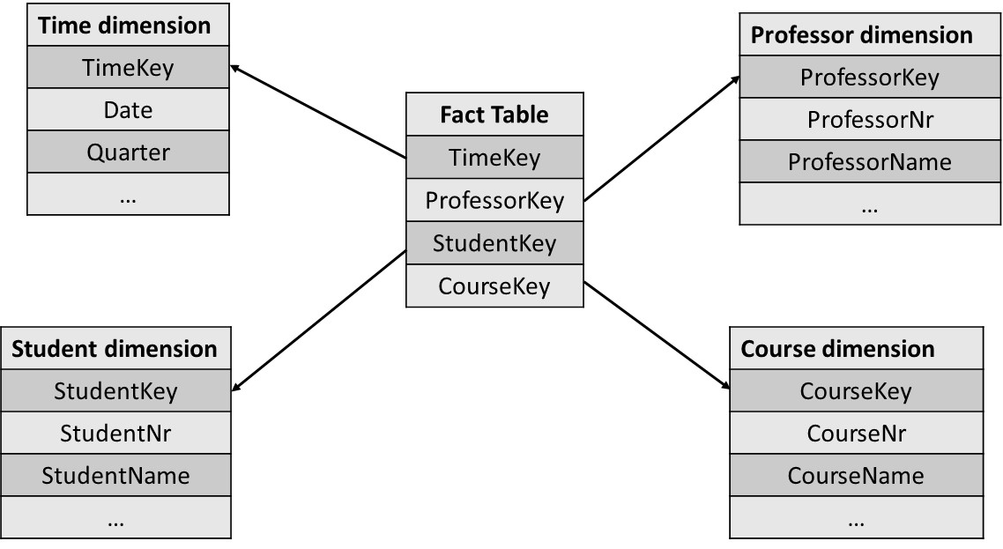
Factless Fact Tables

Slide 16
Optimizing Dimensions
Dimension columns/tables should be heavily indexed to improve query execution time

Slide 17
Junk Dimensions
Junk dimension is a dimension that simply enumerates all feasible combinations of values of the low cardinality attribute types such as flags or indicators
Example: On-line Purchase (Y/N), Payment (cash or credit-card), Discount (Y/N)
JunkKey1 | On-line purchase | Payment | Discount
1 | Yes | Credit-card | Yes
2 | Yes | Credit-card | No
3 | No | Credit-card | Yes
4 | No | Credit-card | No
5 | No | Cash | Yes
6 | No | Cash | No

Slide 18
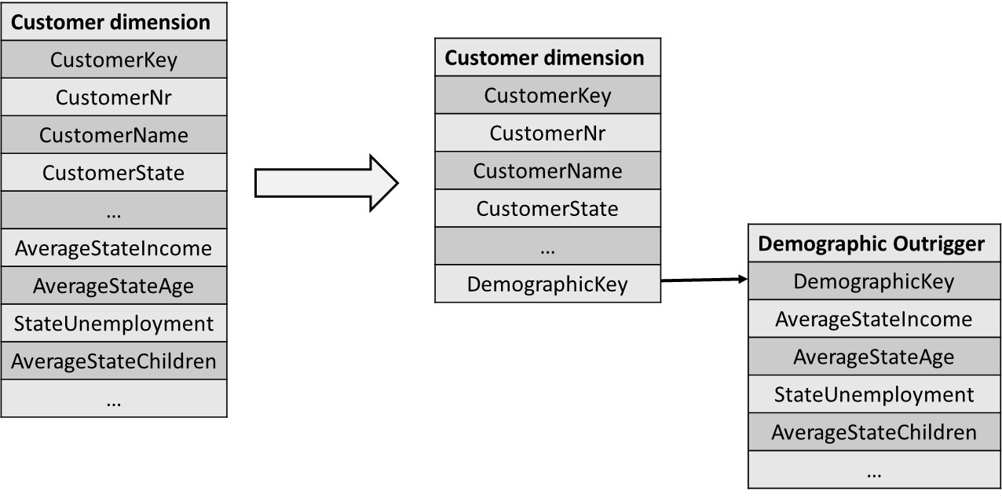
Outrigger tables
Outrigger tables can only be related to dimension tables, where the outrigger table is the parent and the dimension table is the child.
When outrigger tables are used in a dimensional model to decompose, or normalize, dimension hierarchies for each many-to-one relationship, the model is called a snowflake schema.
Though most data warehouse experts recommend against normalizing data in a warehouse because it reduces the querying performance gained by a star schema.

Slide 19
Slowly Changing Dimensions
Dimensions that change slowly and irregularly over a period of time
Example: customer segment ranging from AAA, AA, A, BBB, … to C, determined on a yearly basis
CustomerKey | CustomerNr | CustomerName | Segment
123456 | ABC123 | Bart Baesens | AA

Slide 20
Slowly Changing Dimensions
Approach 1
OLD STATUS
CustomerKey | CustomerNr | CustomerName | Segment
123456 | ABC123 | Bart Baesens | AA
NEW STATUS
CustomerKey | CustomerNr | CustomerName | Segment
123456 | ABC123 | Bart Baesens | AAA

Slide 21
Slowly Changing Dimensions
Approach 2
OLD STATUS
CustomerKey | CustomerNr | CustomerName | Segment
123456 | ABC123 | Bart Baesens | AA
NEW STATUS
CustomerKey | CustomerNr | CustomerName | Old Segment | New Segment
123456 | ABC123 | Bart Baesens | AA | AAA

Slide 22
Slowly Changing Dimensions
Approach 3
OLD STATUS
CustomerKey | CustomerNr | CustomerName | Segment | Start_Date | End_Date | Current_Flag
123456 | ABC123 | Bart Baesens | AA | 27-02-2014 | 31-12-9999 | Y
NEW STATUS
CustomerKey | CustomerNr | CustomerName | Segment | Start_Date | End_Date | Current_Flag
123456 | ABC123 | Bart Baesens | AA | 27-02-2014 | 27-02-2015 | N
123457 | ABC123 | Bart Baesens | AAA | 28-02-2015 | 31-12-9999 | Y

Slide 23
Rapidly changing dimensions
Dimensions that change rapidly and regularly over a period of time
Separate rapidly changing attribute by implementing junk dimension
PATIENT
Patient_id
Name
Gender
Marital_status
PATIENT
Patient_id
Name
Gender
Marital_status
Weight
BMI
PATIENT_VISIT
Visit_ID
Patient_id
Visit_Date
Weight
BMI

Slide 24
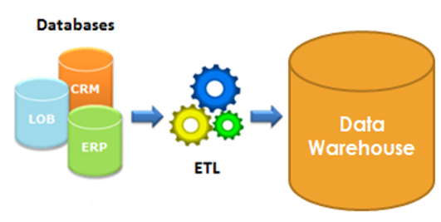
Extract, Transform, Load (ETL) Process
Capture data from multiple, heterogeneous sources and integrate into a single persistent store
ETL activities
extract data
transform data
load transformed data
Can consume up to 80% of all efforts needed to set up a data warehouse

Slide 25
ETL Process
Extraction
Full or incremental
Transformation
formatting
cleansing
aggregation and merging
enrichment
Loading
Fill the fact and dimension tables
Documentation and metadata

Slide 26
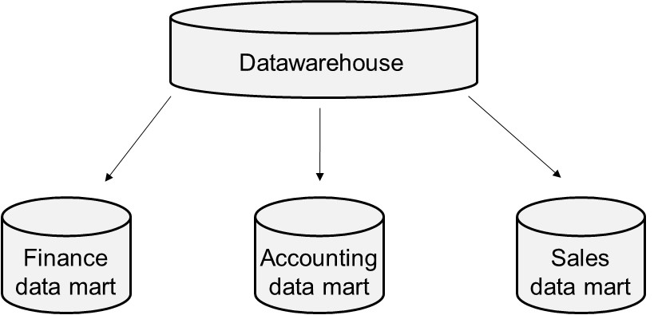
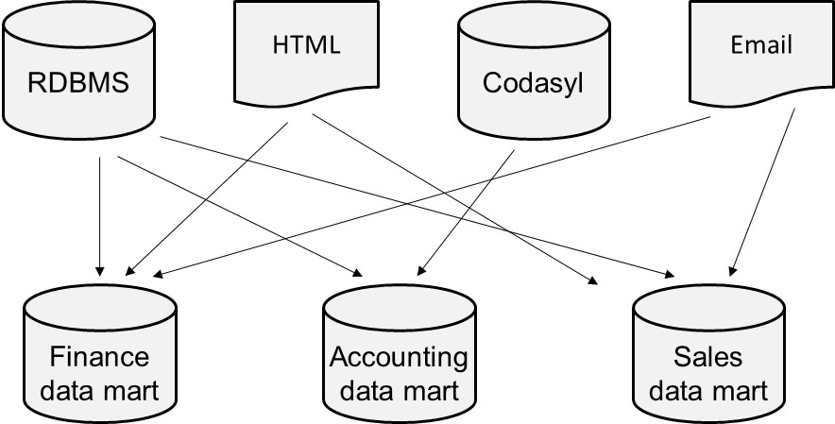
Data Marts
A data mart is a scaled down version of a data warehouse aimed at meeting the information needs of a homogeneous small group of end-users such as a department or business unit
Provide focused content + improve query performance
Dependent data marts pull their data directly from a central data warehouse
Independent data marts are standalone systems drawing data directly from the operational systems, external sources or a combination of both

Slide 27
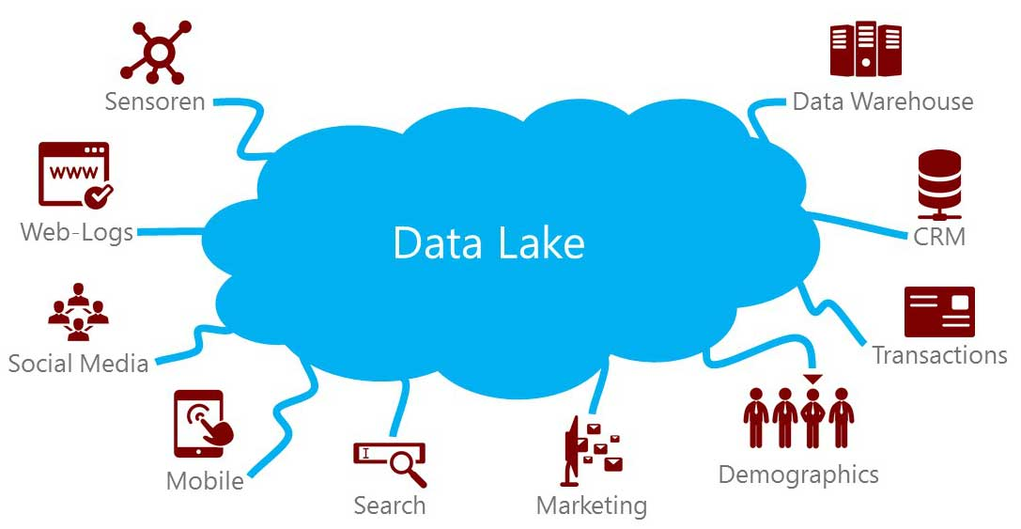
Data Lake
A data lake is a centralized repository that allows you to store all your structured and unstructured data at any scale
You can store your data as-is, without having to first structure the data, and run different types of analytics—from dashboards and visualizations to big data processing, real-time analytics, and machine learning to guide better decisions

Slide 28
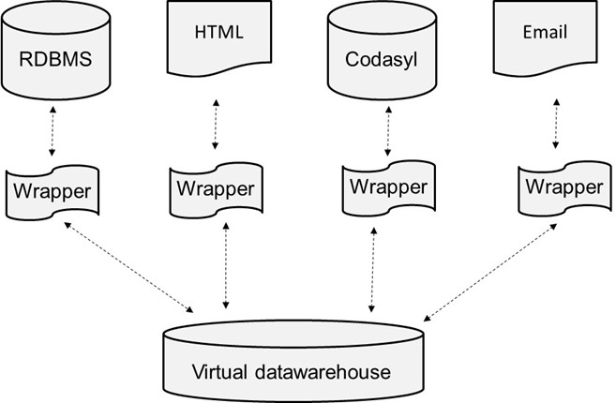
Virtual Data Warehouses and Virtual Data Marts
Idea of virtualization is to use middleware to create a logical or virtual data warehouse or virtual data mart which has no physical data but provides a single point of access to a set of underlying physical data stores
Data is only accessed (‘pulled’) at query time
Virtual Data warehouse can be built as a set of SQL views directly on the underlying operational data sources
Disadvantages
Extra processing capacity from the underlying (operational) data sources
Not possible to keep track of historical data

Slide 29
Business Intelligence
Business intelligence (BI) is referred to as the set of activities, techniques and tools aimed at understanding patterns in past data and predicting the future.
It’s all about Data. Garbage In, Garbage Out (GiGo)
BI techniques
(Ad hoc) Query and Reporting
Pivot tables
OLAP
Data Mining

Slide 30
Query and Reporting
Business user can graphically and interactively design a query and corresponding report
Self Service BI
Query by Example (QBE)
a query is composed in a user-friendly and visual way
Reports can be refreshed at any time
Innovative visualization techniques

Slide 31
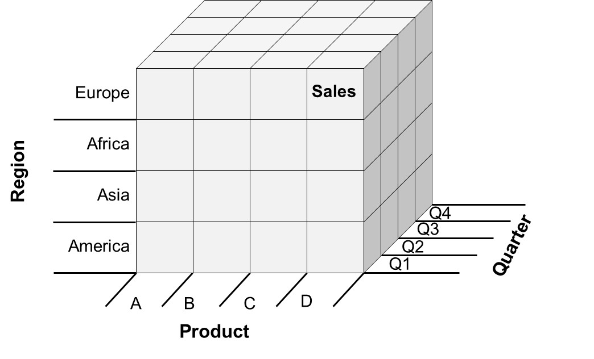
Pivot tables
A pivot or cross-table is a popular data summarization tool
It essentially cross-tabulates a set of dimensions in such a way that multidimensional data can be represented in a two-dimensional tabular format
Sales |  | Quarter |  |  |  | Total
 |  | Q1 | Q2 | Q3 | Q4
Region | Europe | 100 | 200 | 50 | 100 | 450
 | Africa | 50 | 100 | 200 | 50 | 400
 | Asia | 20 | 50 | 10 | 150 | 230
 | America | 50 | 10 | 100 | 100 | 260
 | Total | 220 | 360 | 360 | 400 | 1340

Slide 32
On-Line Analytical Processing (OLAP)
OLAP allows you interactively analyze the data, summarize it and visualize it in various ways
Provide the business-user with a powerful tool for ad-hoc querying
An OLAP cube is a multidimensional database that is optimized for data warehouse and online analytical processing (OLAP) applications.
Types
MOLAP
ROLAP
HOLAP

Slide 33
MOLAP
Multidimensional OLAP (MOLAP) stores the multidimensional data using a Multidimensional DBMS (MDBMS) whereby the data is stored in a multi-dimensional array-based data structure optimized for efficient storage and quick access.
Fast in terms of data retrieval
More storage space needed
Scales poorly when the number of dimensions increases
No universal SQL-like standard is provided
Not optimized for transaction processing

Slide 34
ROLAP
Relational OLAP (ROLAP) stores the data in a relational data warehouse, which can be implemented using a star, snowflake or fact constellation schema
ROLAP scales better to more dimensions than MOLAP
ROLAP query performance may however be inferior to MOLAP

Slide 35
HOLAP
Hybrid OLAP (HOLAP) tries to combine the best of both MOLAP and ROLAP
RDBMS used to store the detailed data in a relational data warehouse whereas the pre-computed aggregated data is kept as a multidimensional array managed by an MDBMS
OLAP analysis first starts from the multidimensional database
Combine the performance of MOLAP with the scalability of ROLAP

Slide 36
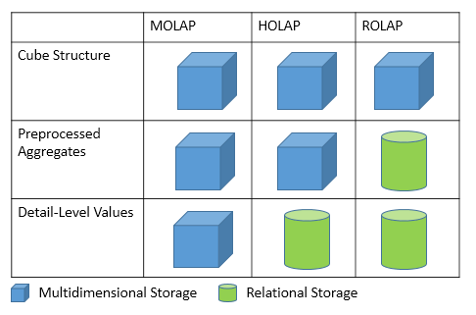
MOLAP, ROLAP and HOLAP

Slide 37
OLAP operators
PRODUCT | QUARTER | REGION | SALES
A | Q1 | Europe | 10
A | Q1 | America | 20
A | Q2 | Europe | 20
A | Q2 | America | 50
A | Q3 | America | 20
A | Q4 | Europe | 10
A | Q4 | America | 30
B | Q1 | Europe | 40
B | Q1 | America | 60
B | Q2 | Europe | 20
B | Q2 | America | 10
B | Q3 | America | 20
B | Q4 | Europe | 10
B | Q4 | America | 40

Slide 38
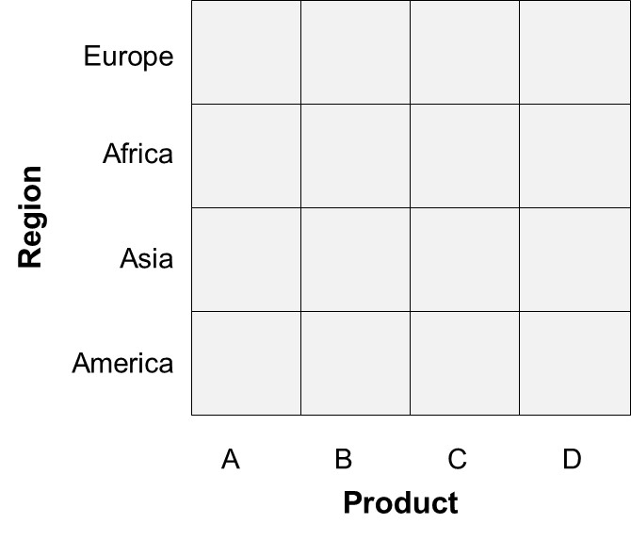
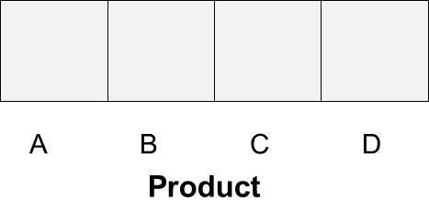
OLAP operators – Roll-up & Drill-down
Drill-up (Roll-up) refers to aggregating the current set of fact values within or across one or more dimensions.
Drill Down refers to zoom in to more detailed data.
Roll-up
Sales
Sales
Drill-down

Slide 39
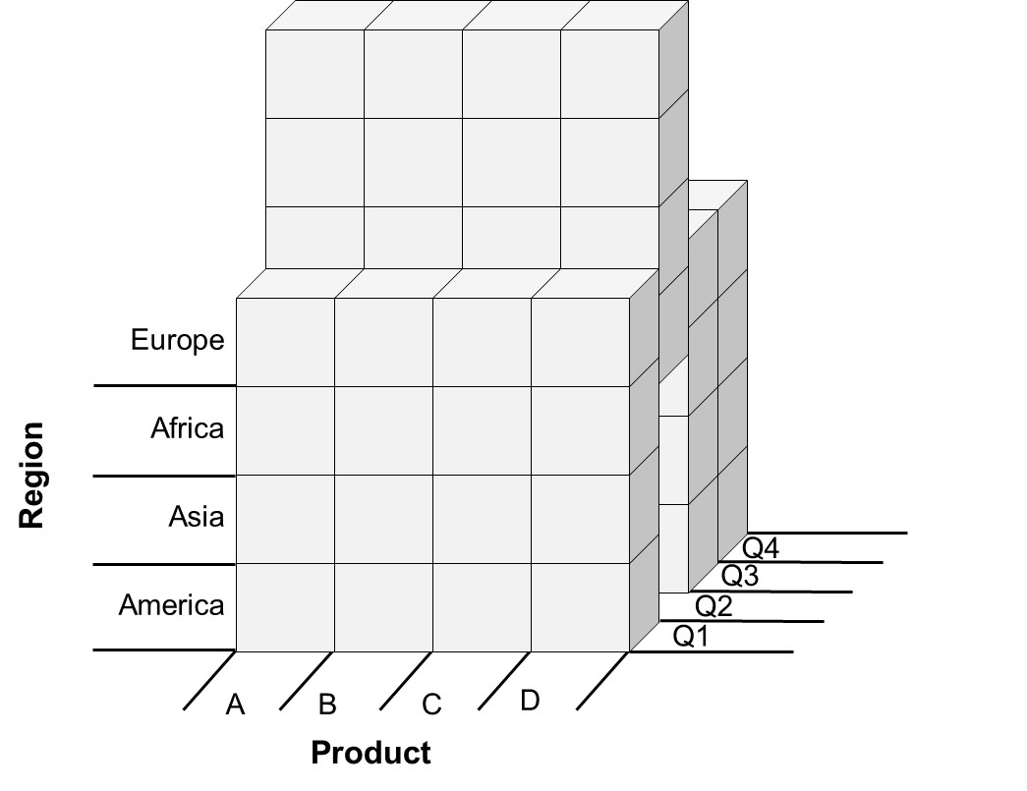
OLAP operators - Slicing
Slicing represents the operation whereby one of the dimensions is set at a particular value.
Quarter

Slide 40
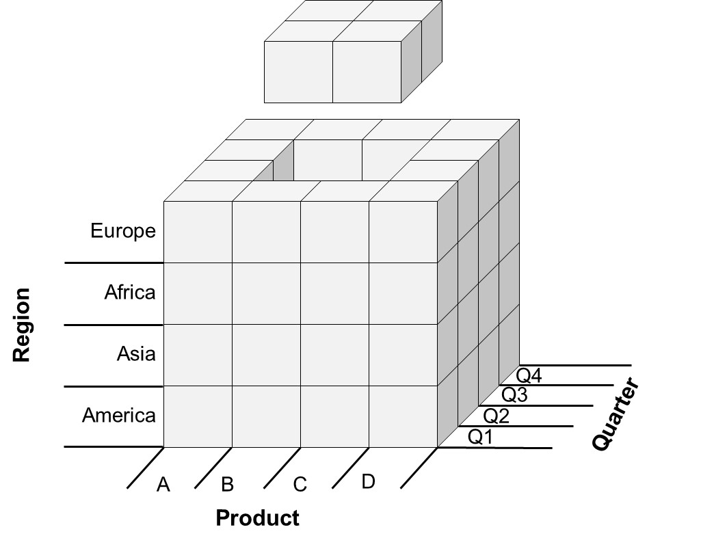
OLAP operators - Dicing
Dicing corresponds to a range selection on one or more dimensions

Slide 41
OLAP queries in SQL – GROUP BY
SQL-99 introduced 3 extensions to the GROUP BY statement with the following three operators:
CUBE
ROLLUP
GROUPING SETS

Slide 42
OLAP queries in SQL – GROUP BY CUBE
PRODUCT | QUARTER | REGION | SALES
A | Q1 | Europe | 10
A | Q1 | America | 20
A | Q2 | Europe | 20
A | Q2 | America | 50
A | Q3 | America | 20
A | Q4 | Europe | 10
A | Q4 | America | 30
B | Q1 | Europe | 40
B | Q1 | America | 60
B | Q2 | Europe | 20
B | Q2 | America | 10
B | Q3 | America | 20
B | Q4 | Europe | 10
B | Q4 | America | 40
QUARTER | REGION | SALES
Q1 | Europe | 50
Q1 | America | 80
Q2 | Europe | 40
Q2 | America | 60
Q3 | Europe | NULL
Q3 | America | 40
Q4 | Europe | 20
Q4 | America | 80
Q1 | NULL | 130
Q2 | NULL | 100
Q3 | NULL | 40
Q4 | NULL | 90
NULL | Europe | 110
NULL | America | 250
NULL | NULL | 360
The CUBE operator computes a union of GROUP BY’s on every subset of the specified attribute types
SELECT QUARTER, REGION, SUM(SALES) FROM SALESTABLE GROUP BY CUBE (QUARTER, REGION)

Slide 43
OLAP queries in SQL – GROUP BY ROLLUP
ROLLUP operator computes the union on every prefix of the list of specified attribute types, from the most detailed up to the grand total
Key difference between the ROLLUP and CUBE operator is that the former generates a result set showing the aggregates for a hierarchy of values of the specified attribute types, whereas the latter generates a result set showing the aggregates for all combinations of values of the selected attribute types

Slide 44
OLAP queries in SQL – GROUP BY ROLLUP
PRODUCT | QUARTER | REGION | SALES
A | Q1 | Europe | 10
A | Q1 | America | 20
A | Q2 | Europe | 20
A | Q2 | America | 50
A | Q3 | America | 20
A | Q4 | Europe | 10
A | Q4 | America | 30
B | Q1 | Europe | 40
B | Q1 | America | 60
B | Q2 | Europe | 20
B | Q2 | America | 10
B | Q3 | America | 20
B | Q4 | Europe | 10
B | Q4 | America | 40
QUARTER | REGION | SALES
Q1 | Europe | 50
Q1 | America | 80
Q2 | Europe | 40
Q2 | America | 60
Q3 | Europe | NULL
Q3 | America | 40
Q4 | Europe | 20
Q4 | America | 80
Q1 | NULL | 130
Q2 | NULL | 100
Q3 | NULL | 40
Q4 | NULL | 90
NULL | NULL | 360
SELECT QUARTER, REGION, SUM(SALES) FROM SALESTABLE GROUP BY ROLLUP (QUARTER, REGION)

Slide 45
OLAP queries in SQL – GROUP BY – GROUPING SETS
GROUPING SETS operator generates a result set equivalent to that generated by a UNION ALL of multiple simple GROUP BY clauses
SELECT QUARTER, REGION, SUM(SALES) FROM SALESTABLE GROUP BY GROUPING SETS ((QUARTER), (REGION))
SELECT QUARTER, NULL, SUM(SALES) FROM SALESTABLE GROUP BY QUARTER UNION ALL SELECT NULL, REGION, SUM(SALES) FROM SALESTABLE GROUP BY REGION

Slide 46
OLAP Queries in SQL
SQL2003 introduced support for 2 types of other activities:
Ranking
RANK(): returns the rank of each row within the partition of a result set.
DENSE_RANK(): returns the rank of each row within a result set partition, with no gaps in the ranking values.
PERCENT_RANK(): calculates the relative rank of a row within a group of rows.
CUME_RANK(): calculates the cumulative distribution of a value within a group of values.
Windowing (Partition By)

Slide 47
OLAP Queries in SQL – RANK()
SELECT
PRODUCT, SALES , RANK() OVER (ORDER BY SALES ASC) as RANK_SALES , DENSE_RANK() OVER (ORDER BY SALES ASC) as DENSE_RANK_SALES
, PERCENT_RANK() OVER (ORDER BY SALES ASC) as PERC_RANK_SALES
, CUME_DIST() OVER (ORDER BY SALES ASC) as CUM_DIST_SALES FROM
SALESTABLE ORDER BY
RANK_SALES ASC

Slide 48
PRODUCT | SALES | RANK_SALES | DENSE_RANK_SALES | PERC_RANK_SALES | CUM_DIST_SALES
B | 5 | 1 | 1 | 0.00000 | 0.05263
B | 5 | 1 | 1 | 0.00000 | 0.05263
A | 7 | 3 | 2 | 0.05405 | 0.07895
A | 8 | 4 | 3 | 0.08108 | 0.10526
A | 10 | 5 | 4 | 0.10811 | 0.23684
A | 10 | 5 | 4 | 0.10811 | 0.23684
B | 10 | 5 | 4 | 0.10811 | 0.23684
B | 10 | 5 | 4 | 0.10811 | 0.23684
B | 10 | 5 | 4 | 0.10811 | 0.23684
B | 11 | 10 | 5 | 0.24324 | 0.26316
A | 12 | 11 | 6 | 0.27027 | 0.28947
… | … | … | … | … | …
A | 50 | 34 | 18 | 0.89189 | 0.97368
B | 50 | 34 | 18 | 0.89189 | 0.97368
B | 50 | 34 | 18 | 0.89189 | 0.97368
B | 50 | 34 | 18 | 0.89189 | 0.97368
B | 60 | 38 | 19 | 1.00000 | 1.00000
Count=3
Count=9
Total_Rank
PERC_RANK_SALES = (RANK_SALES -1)/(Total_Rank-1)
PERC_RANK_SALES (3) = (3-1)/(38-1)=0.05405
PERC_RANK_SALES (5) = (5-1)/(38-1)=0.10811
CUM_DIST_SALES = RANK_SALES_Count/Total_Rank
PERC_RANK_SALES (3) = 3/38 = 0.07895
PERC_RANK_SALES (5) = 9/38 = 0.23684

Slide 49
OLAP Queries in SQL - WINDOWING
Windowing allows calculating cumulative totals or running averages based on a specified time window
Windowing functions are a great way to get different perspectives on a set of data without having to make repeat calls to the server for that data
Window functions all use the OVER() clause, which is used to define how the function is evaluated
The OVER() clause accepts three different arguments:
PARTITION BY: Resets its counter every time the stated column(s) changes values
ORDER BY: Orders the rows the function will evaluate. This does not order the entire result set, only the way the function proceeds through the rows
ROWS BETWEEN: Specifies how to further limit the rows evaluated by the function

Slide 50
OLAP Queries in SQL - Windowing
SELECT
QUARTER, REGION, SALES
, AVG(SALES) OVER (PARTITION BY REGION ORDER BY QUARTER ROWS BETWEEN 1 PRECEDING AND 1 FOLLOWING) AS SALES_AVG FROM
SALESTABLE ORDER BY
REGION, QUARTER, SALES_AVG
QUARTER | REGION | SALES
1 | America | 10
2 | America | 20
3 | America | 10
4 | America | 30
1 | Europe | 10
2 | Europe | 20
3 | Europe | 10
4 | Europe | 20
QUARTER | REGION | SALES | SALES_AVG
1 | America | 10 | 15
2 | America | 20 | 13,33
3 | America | 10 | 20
4 | America | 30 | 20
1 | Europe | 10 | 15
2 | Europe | 20 | 13,33
3 | Europe | 10 | 16,67
4 | Europe | 20 | 15

Slide 51
www.pdbmbook.com

